Slide 1
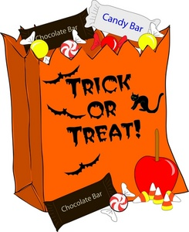
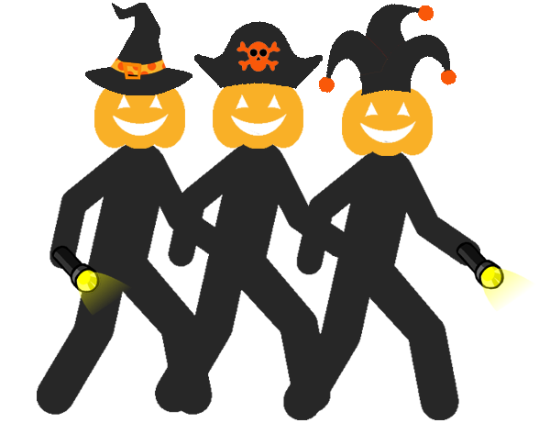
A safety guide for ghosts and ghouls.
While trick-or-treating for your candy, make sure to keep these safety tips handy.

Slide 2
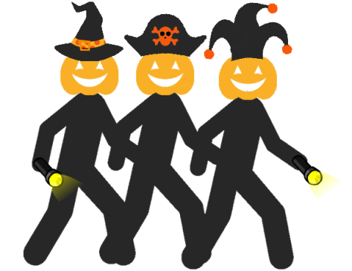
Whether you are wearing a mask or a tiara, make sure you include reflective clothing with your costume!

Slide 3
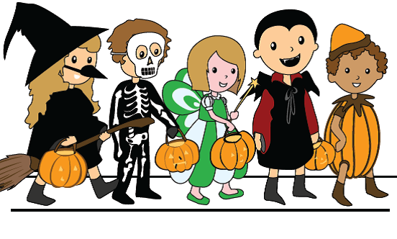
Make sure while you are going door to door, to look both ways when crossing streets!

Slide 4
Don’t forget to grab a glow stick or flashlight before you leave for trick-or-treating!

Slide 5
Stay alert and only trick-or treat in well-lit neighborhoods!

Slide 6
Before you dive into your bag of treats, make sure you have an adult check any open candy!

Slide 7
Stay safe and never approach a stranger’s car or go into a stranger’s home!

Slide 8
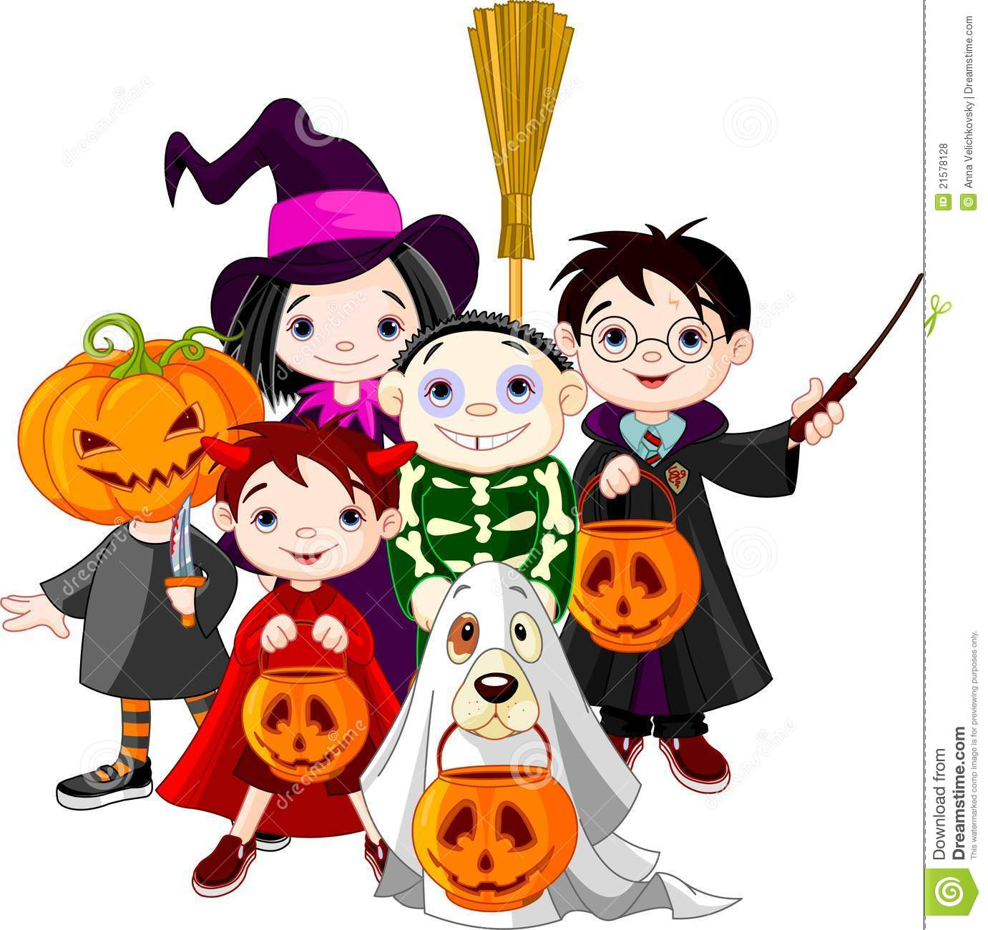
Grab a friend or your parents and make sure you travel in a group and with an adult!

Slide 9
Check out this video to review the safety tips we just went over!
https://youtu.be/Ful7kykz4TU

Slide 10
Remember to have FUN and be SAFE on Halloween!
Brought to you by: YOVASO, Virginia State Police,
and the Virginia DMV Highway Safety Office
Download this PowerPoint at
yovaso.org.
(Click on campaigns / Halloween Safety)

